Slide 1
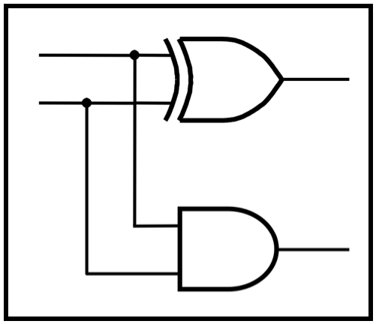
CprE 281:
Digital Logic
Instructor: Alexander Stoytchev
http://www.ece.iastate.edu/~alexs/classes/

Slide 2
FSM as an Arbiter Circuit
CprE 281: Digital Logic
Iowa State University, Ames, IA
Copyright © Alexander Stoytchev

Slide 3
Administrative Stuff
Homework 11 is out
It is due on Monday Nov 28 @ 4pm

Slide 4
Administrative Stuff
Homework 12 is out
It is due on Monday Dec 5 @ 4pm

Slide 5
Administrative Stuff
Final Project (7% of your grade)
Read the instructions in the e-mail that I sent you.
Let me know if you did not get that e-mail.
Also, posted on the class web page (Labs section)
This is your lab for the last two weeks
This is due during your last lab (dead week)

Slide 6
Arbiter Circuit

Slide 7
Goal
Design a machine that controls access by several devices to a shared resource
The resource can be used by only one device at a time
Any changes can occur only on the positive edge of the clock signal
Each device provides one input to the FSM, which is called a request
The FSM produces one output for each device, which is called a grant

Slide 8
Goal
The requests from the devices are prioritized
If two requests are active at the same time, then only the device with the highest priority will be given access to the shared resource
After a device is done with the shared resource, it must make its request signal equal to 0.
If there are no outstanding requests, then the FSM stays in an Idle state

Slide 9
Conceptual Diagram
Request1
Grant1
Device 1
Request2
Arbiter
Shared
Grant2
Device 2
resource
Request3
Grant3
Device 3

Slide 10
Conceptual Diagram
Request1
Grant1
Device 1
Request2
Arbiter
Shared
Grant2
Device 2
resource
Request3
Grant3
Device 3
Request (r)
Grant (g)
[ Figure 9.20 from the textbook ]

Slide 11
State diagram for the arbiter
Reset
000
Idle
0xx
1xx
gnt1
⁄
g
=
1
1
x0x
1xx
01x
gnt2
⁄
g
=
1
2
xx0
x1x
001
gnt3
⁄
g
=
1
3
xx1
[ Figure 6.72 from the textbook ]

Slide 12
State diagram for the arbiter
Reset
000
Idle
Highest Priority Device
0xx
1xx
gnt1
⁄
g
=
1
1
x0x
1xx
01x
gnt2
⁄
g
=
1
2
xx0
x1x
001
gnt3
⁄
g
=
1
3
xx1

Slide 13
State diagram for the arbiter
Reset
000
Idle
Highest Priority Device
0xx
1xx
gnt1
⁄
g
=
1
1
x0x
1xx
01x
gnt2
⁄
g
=
1
2
Lowest Priority Device
xx0
x1x
001
gnt3
⁄
g
=
1
3
xx1

Slide 14
State diagram for the arbiter
000
The three request bits
Reset
r₁ r₂ r₃
Idle
0xx
1xx
gnt1
⁄
g
=
1
1
x0x
1xx
01x
gnt2
⁄
g
=
1
2
xx0
x1x
001
gnt3
⁄
g
=
1
3
xx1

Slide 15
State diagram for the arbiter
Each device must
release the resource
after it is done using it
Reset
000
Idle
0xx
1xx
gnt1
⁄
g
=
1
1
x0x
1xx
01x
gnt2
⁄
g
=
1
2
xx0
x1x
001
gnt3
⁄
g
=
1
3
xx1

Slide 16
Alternative style of state diagram for the arbiter
Reset
r
1
r
2
r
3
Idle
r
1
r
1
gnt1
⁄
g
=
1
1
r
r
1
r
r
2
1
2
gnt2
⁄
g
=
1
2
r
3
r
2
r
r
r
1
2
3
gnt3
⁄
g
=
1
3
r
3
[ Figure 6.73 from the textbook ]

Slide 18
Let's look at a simpler example with only two devices that need to use the shared resource

Slide 19
State diagram for the simpler arbiter
Reset
00
Idle
0x
1x
gnt1
⁄
g
=
1
1
x0
1x
01
gnt2
⁄
g
=
1
2
x1

Slide 20
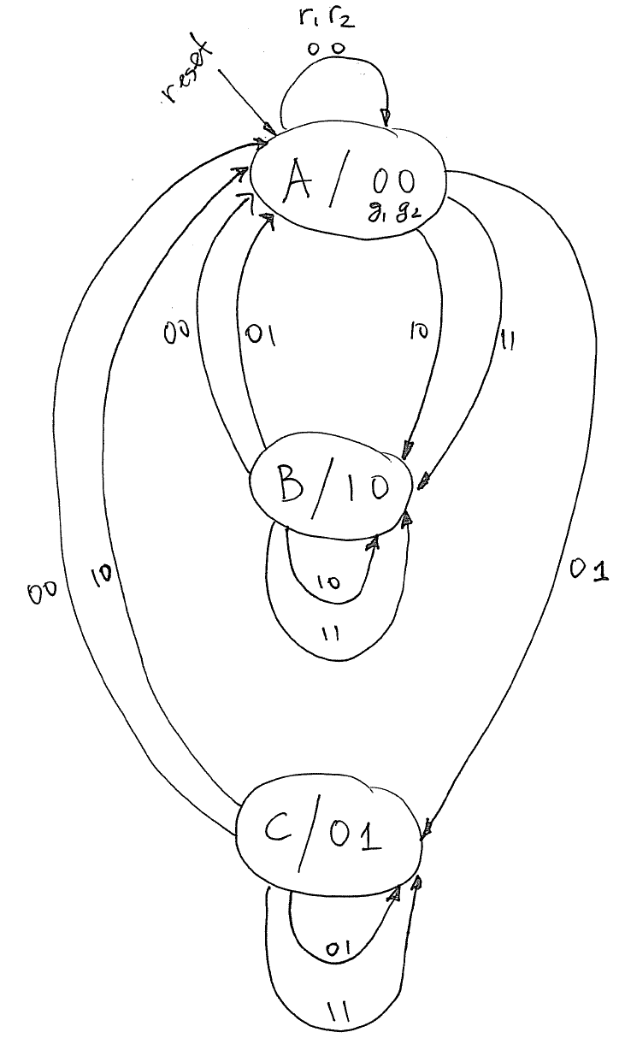
State diagram for the arbiter circuit

Slide 21
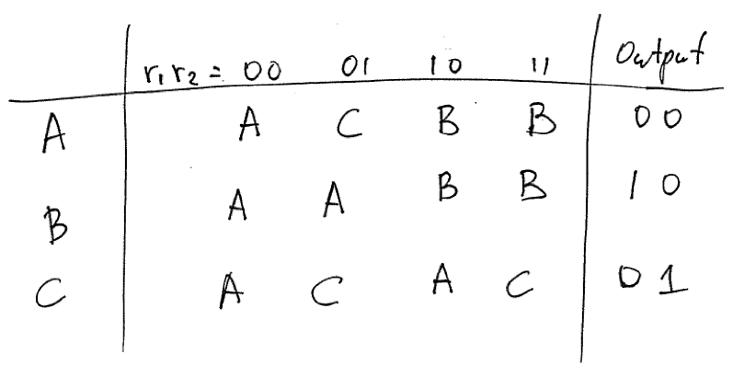
State Table

Slide 22
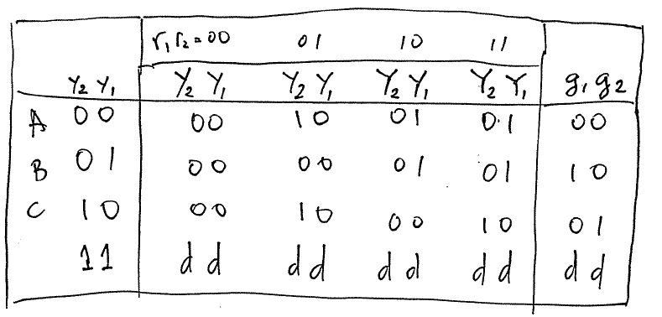
State-Assigned Table

Slide 23
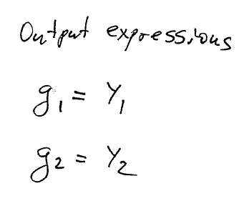
Output Expressions

Slide 24
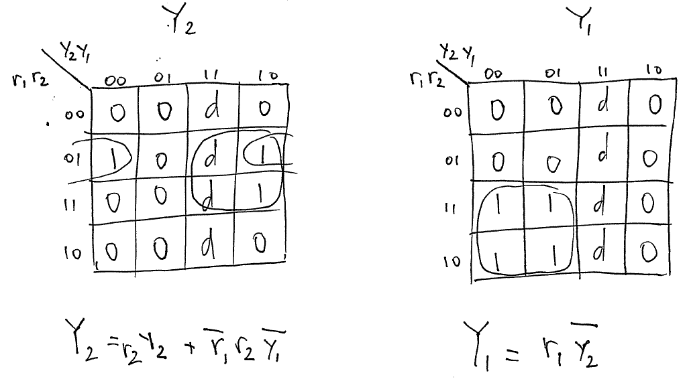
Next State Expressions

Slide 25
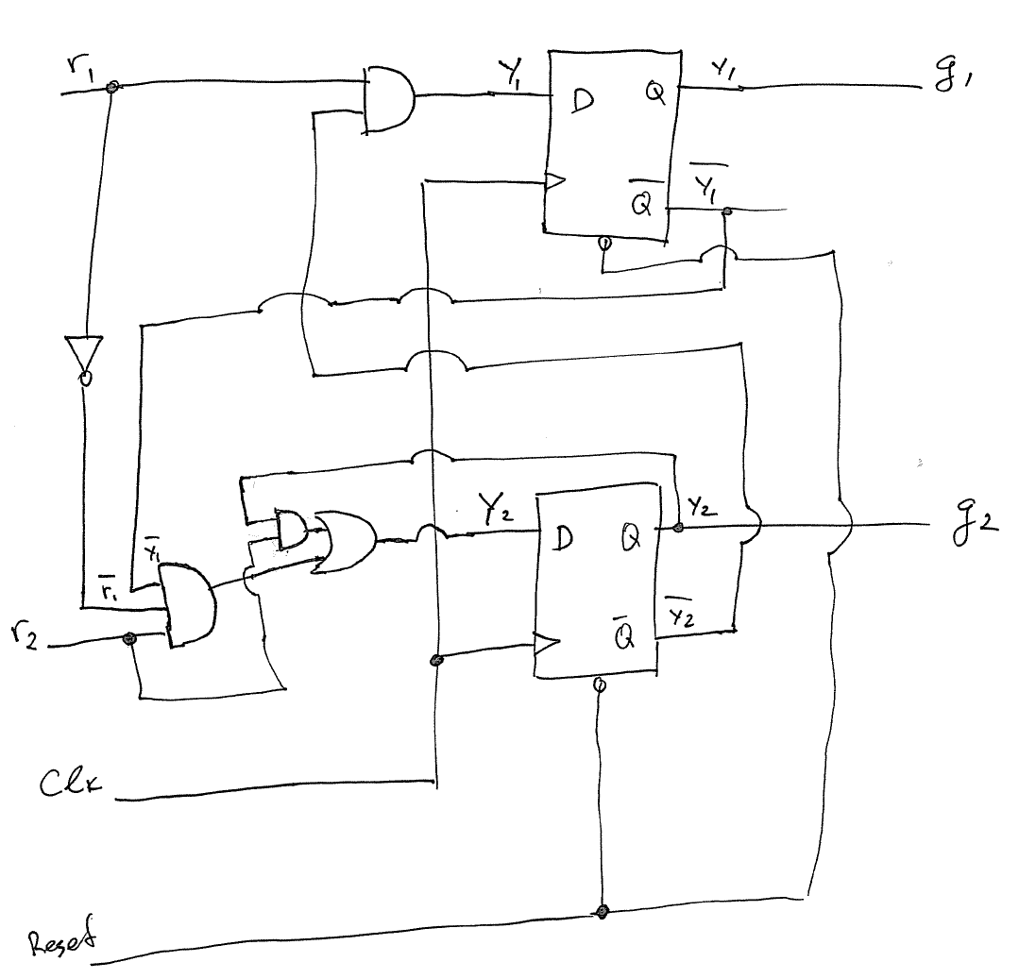
Circuit Diagram

Slide 26
Questions?

Slide 27
THE END

